Slide 1


Slide 2

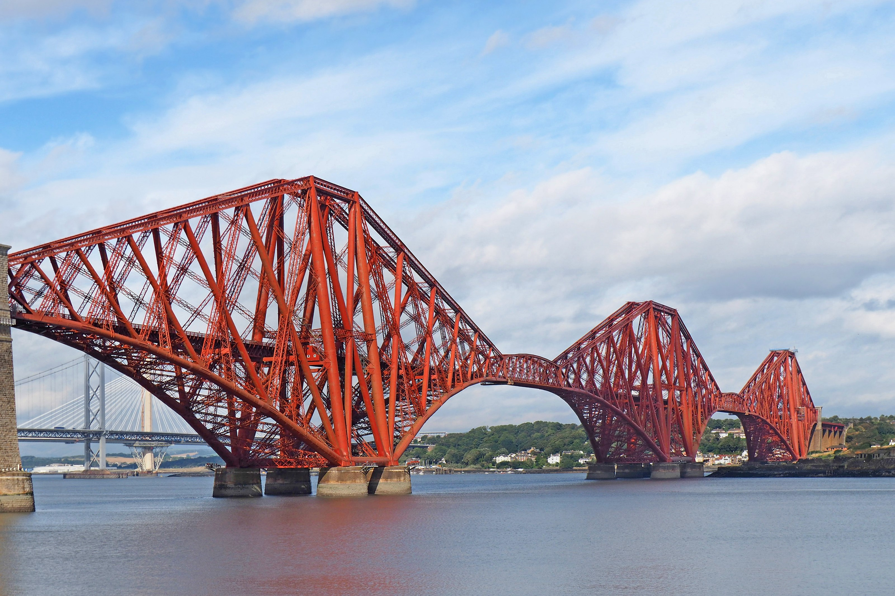
INSPIRATION FOR OUR PROBLEM
This image of a 3D arch bridge was the inspiration for our problem statement. We chose this particularly because:
The Fourth Bridge looks different and strong.
It works on the cantilever principle seen in many big bridges.
It helped us connect theory with real life.
We understood how loads act on large bridges.
It was a good example to learn structural analysis.

Slide 3


Slide 4
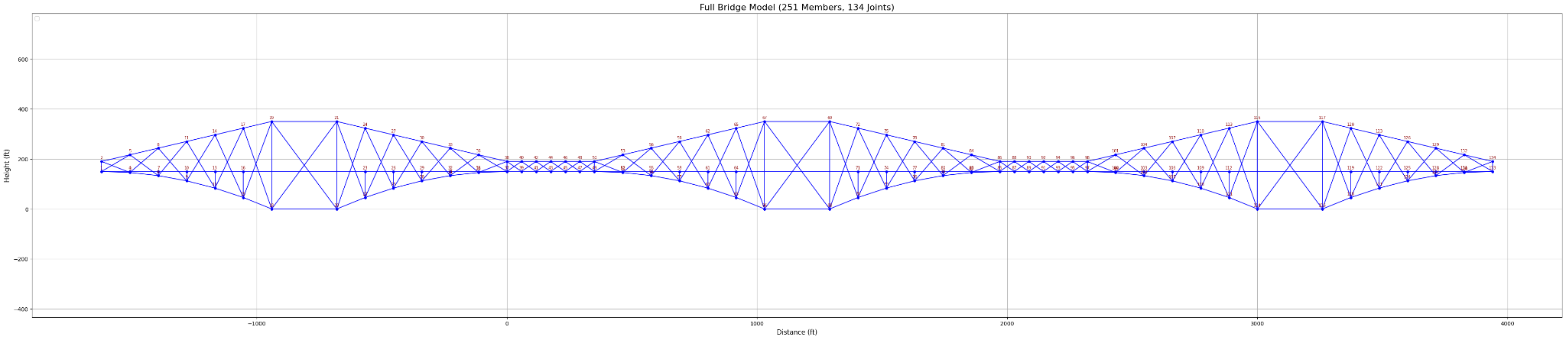
FULL BRIDGE MODEL

Slide 5
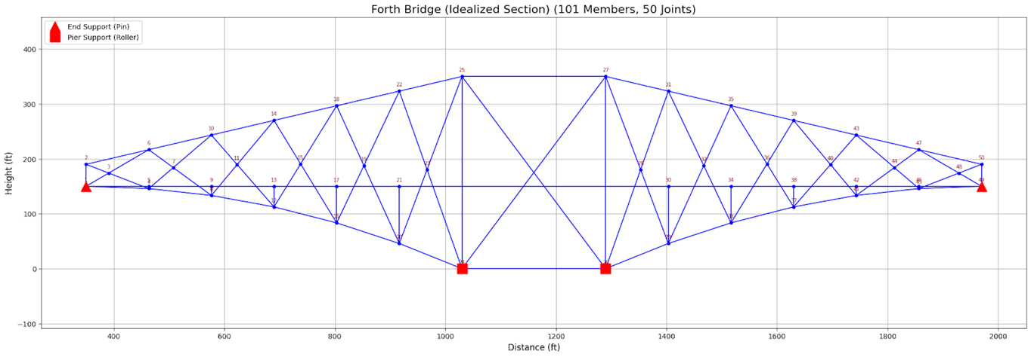
IDEALIZED SECTION OF THE BRIDGE

Slide 6
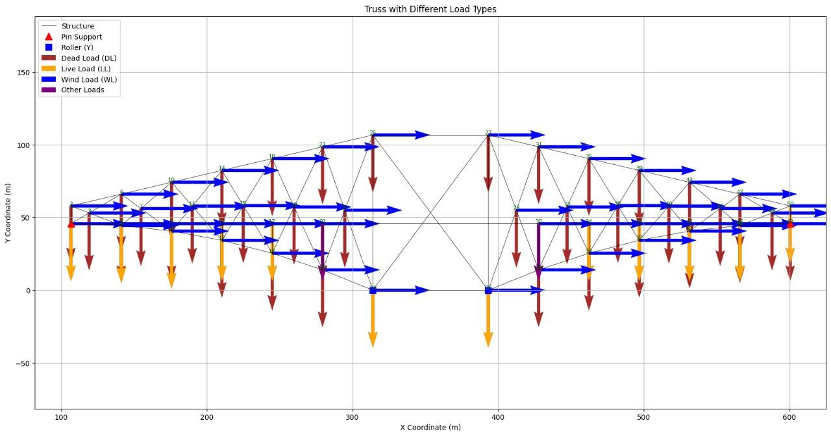
TYPES OF LOAD ACTING ON THE STRUCTURE
Dead Load (DL)
Live Load (LL)
Wind Load (WL)
Other Loads

Slide 7
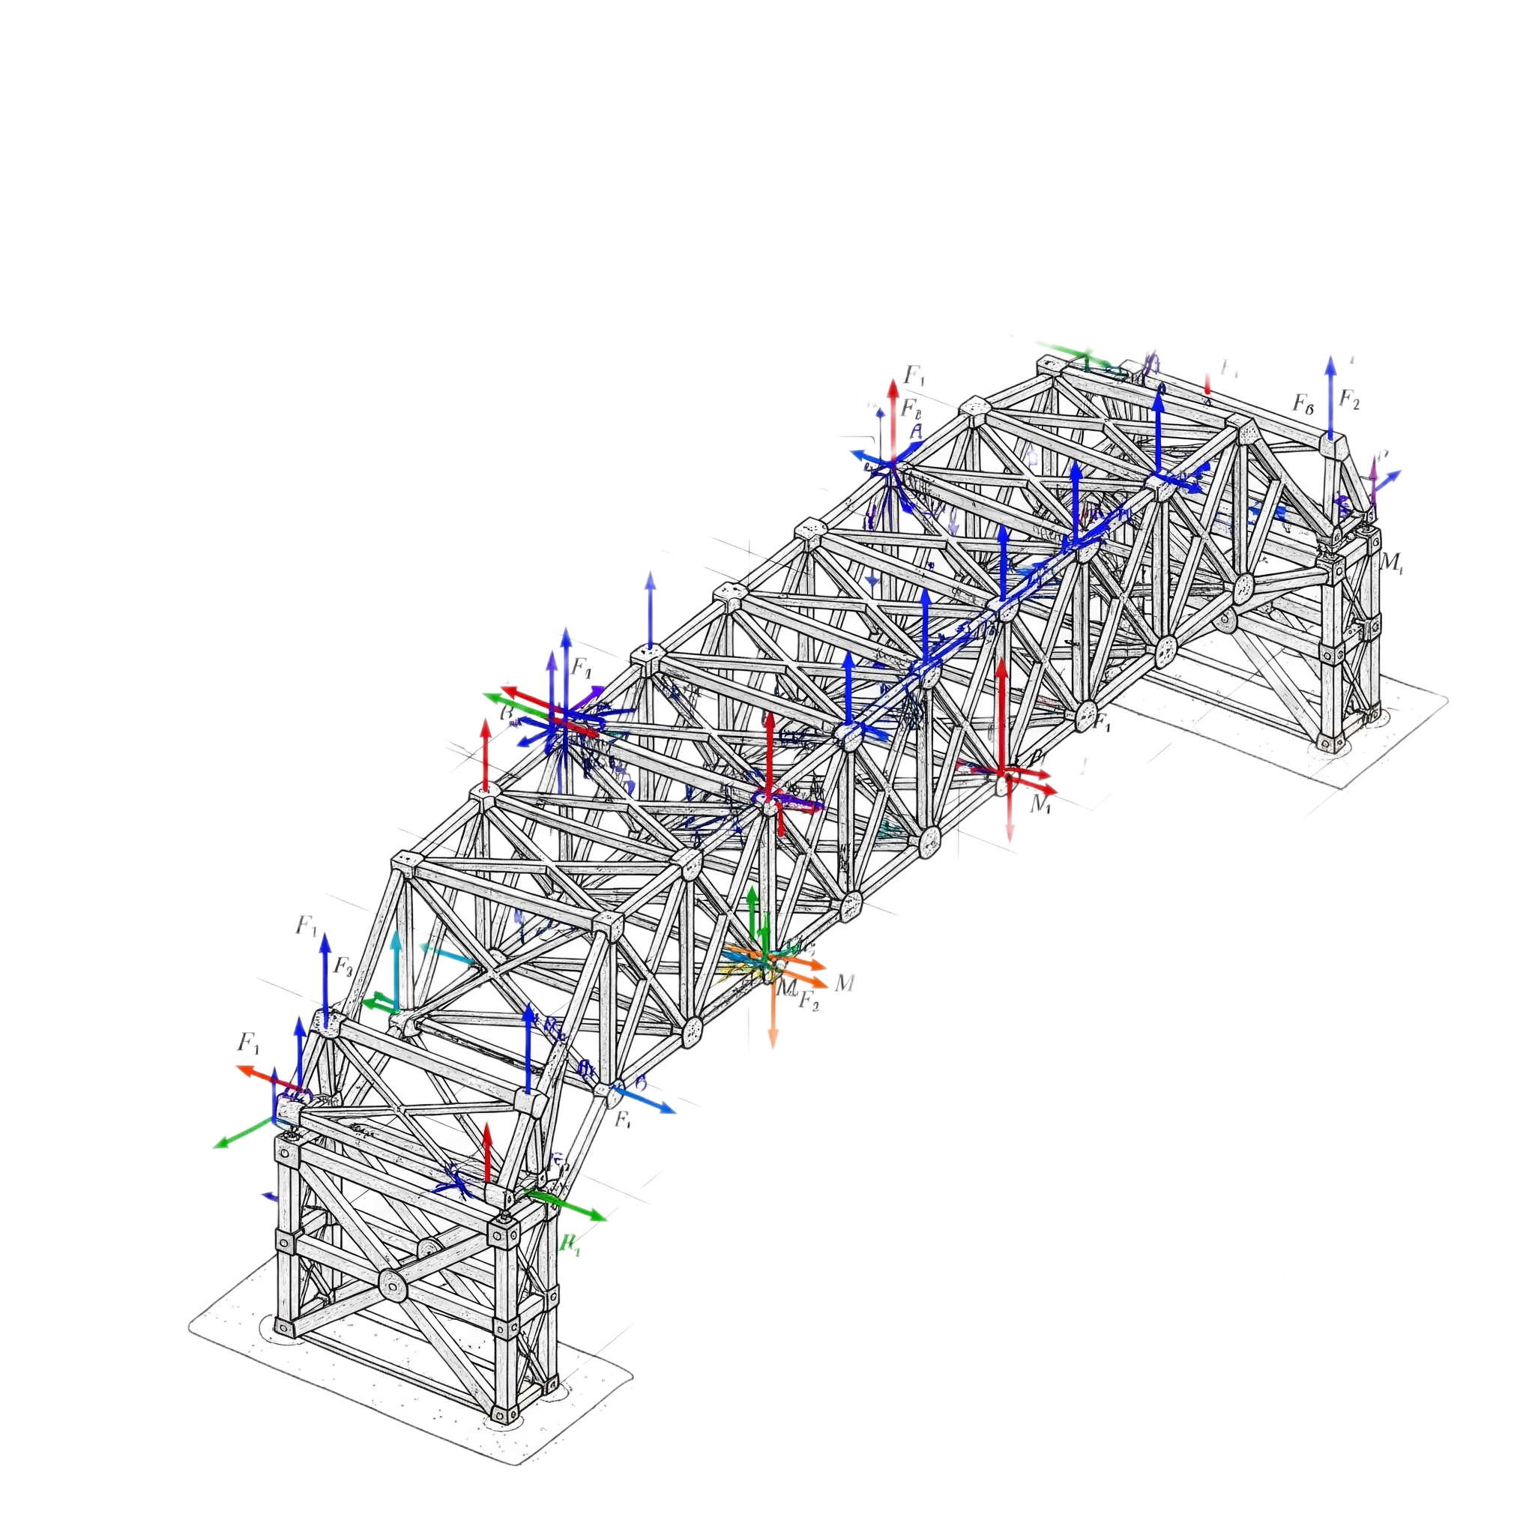
SOLUTION APPROACH
Fundamental relation is Force equals Stiffness times Displacement. {F}=[K]{d}
Element stiffness matrix is derived in local coordinates. [k]=[T]^{T}[ke​][T]
Transformation matrix converts local to global coordinates.
Global stiffness matrix is found using the transformation.
Nodal displacements are solved using the inverse global stiffness. {d}=[K]⁻¹{F}
Member forces are computed with the element stiffness. {Fe​}=[ke​]{de​}

Slide 8

DEMONSTRATION OF CODES

Slide 9
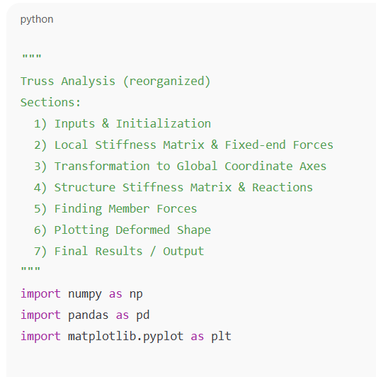
Inputs & Initialization

Slide 10
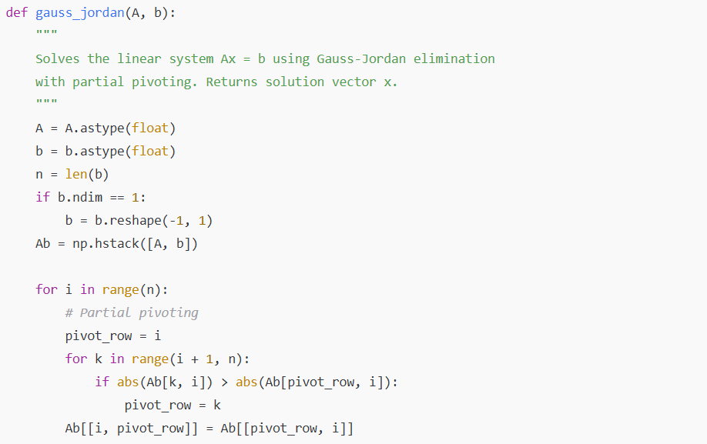
Inputs & Initialization

Slide 11
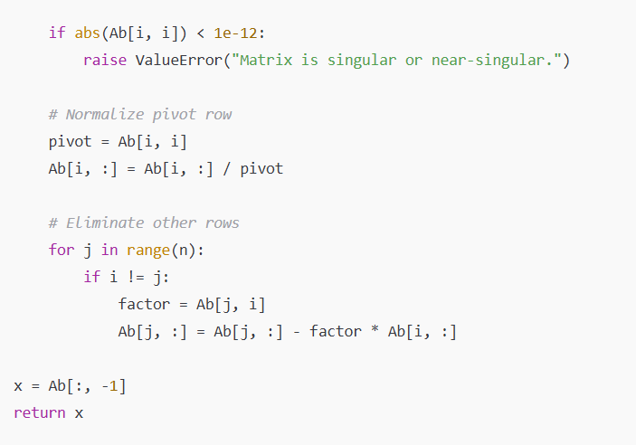
Inputs & Initialization

Slide 12
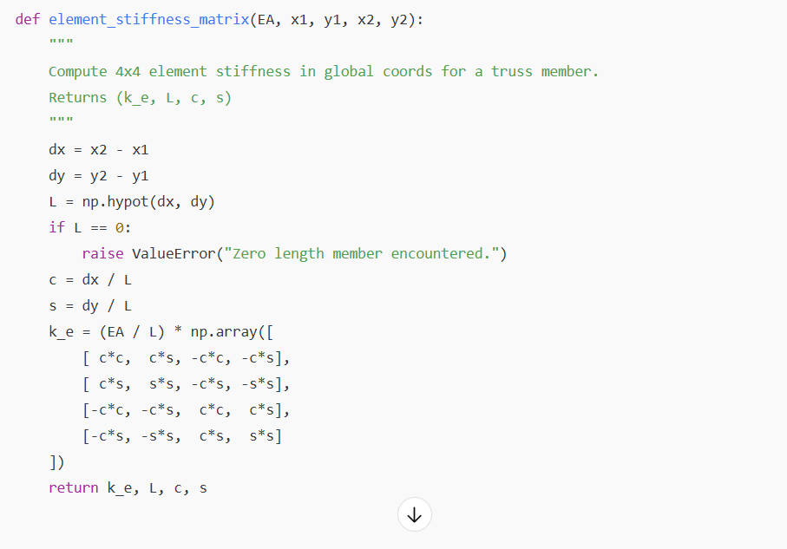
LOCAL STIFFNESS MATRIX & FIXED-END FORCES

Slide 13
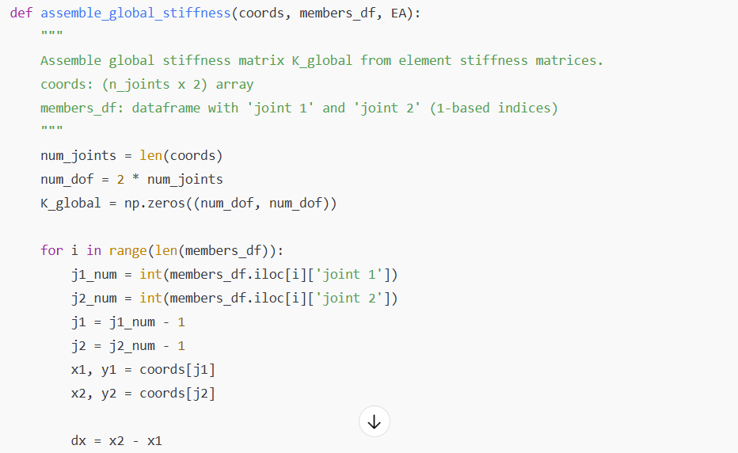
STRUCTURE STIFFNESS MATRIX & REACTIONS

Slide 14
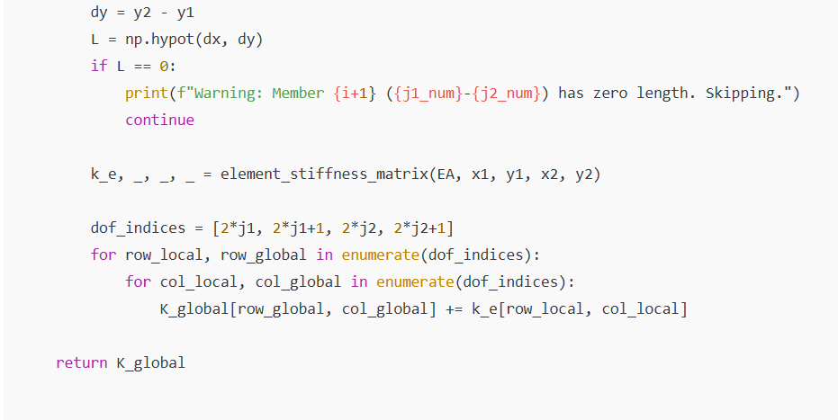
STRUCTURE STIFFNESS MATRIX & REACTIONS

Slide 15
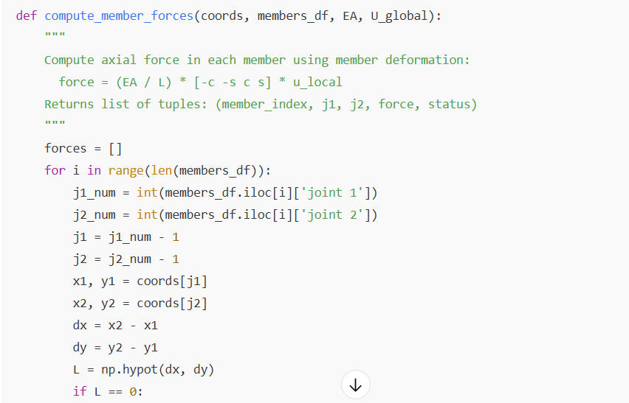
FINDING MEMBER FORCES

Slide 16
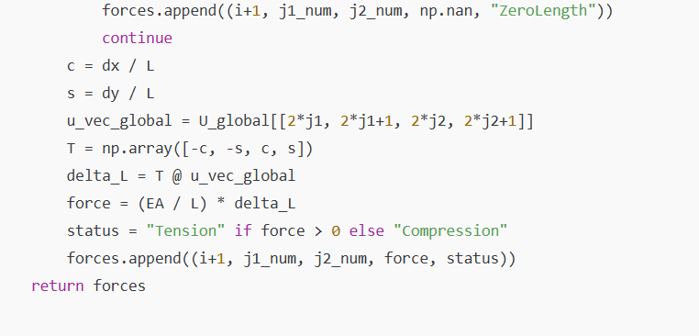
FINDING MEMBER FORCES

Slide 17
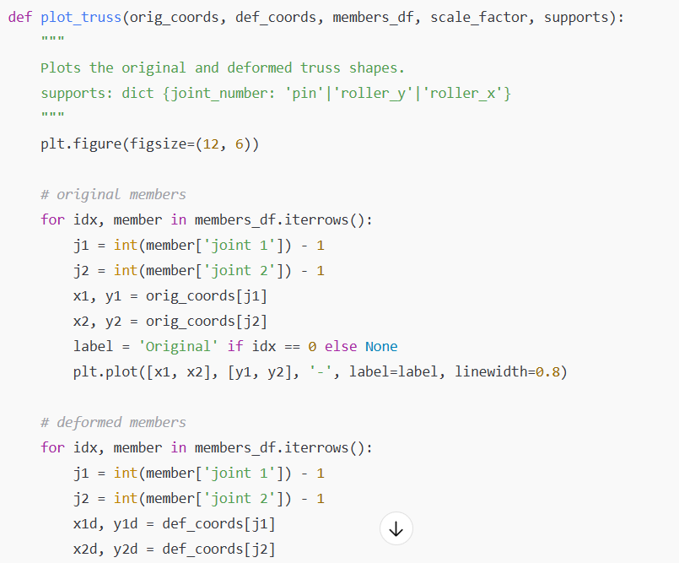
PLOTTING DEFORMED SHAPE

Slide 18
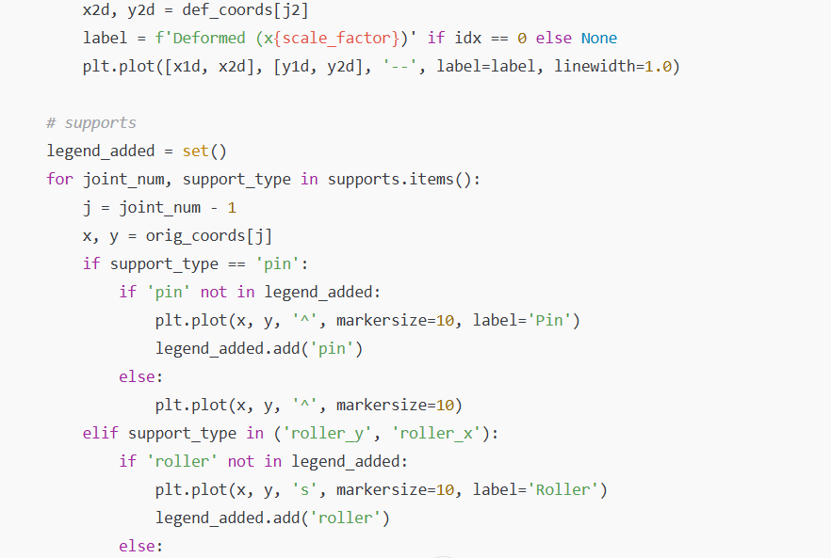
PLOTTING DEFORMED SHAPE

Slide 19
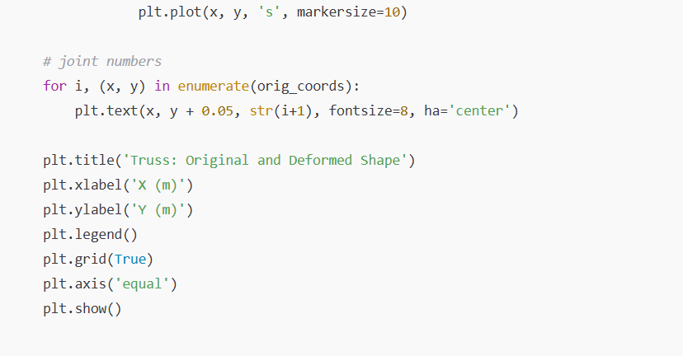
PLOTTING DEFORMED SHAPE

Slide 20
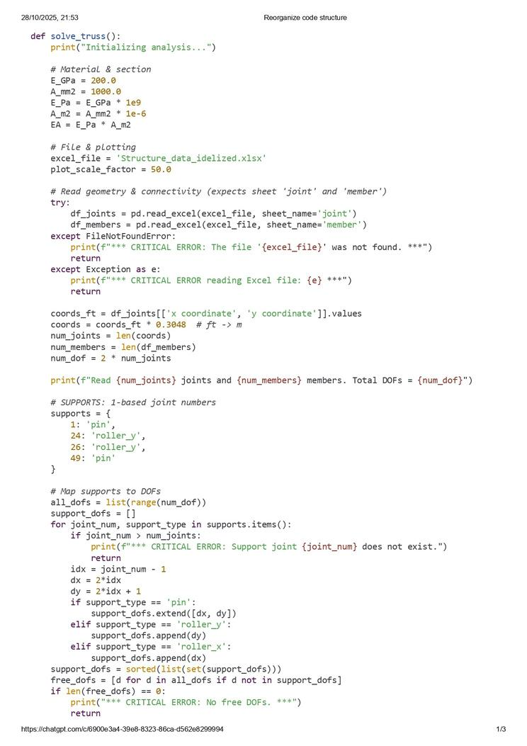
SOLVING TRUSS

Slide 21
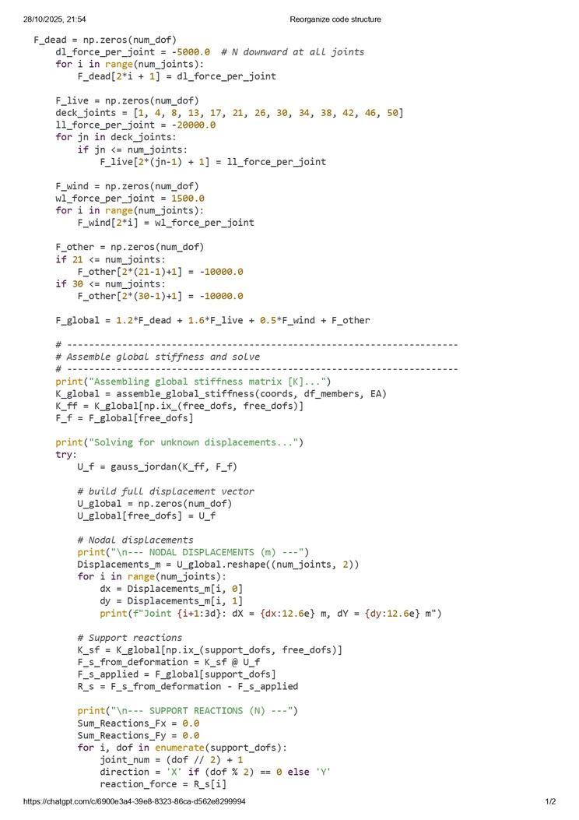
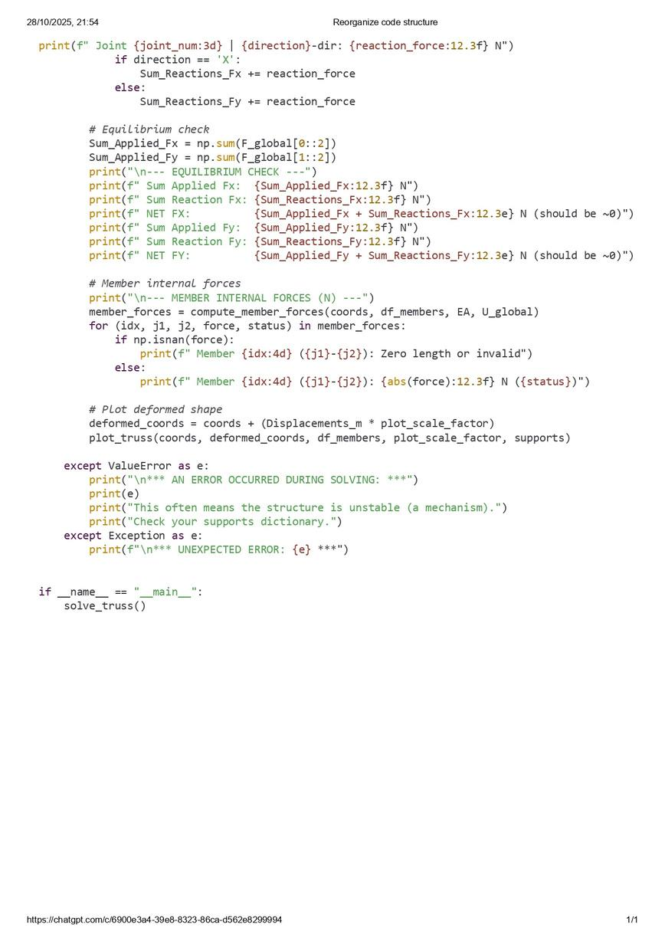
SOLVING TRUSS

Slide 22
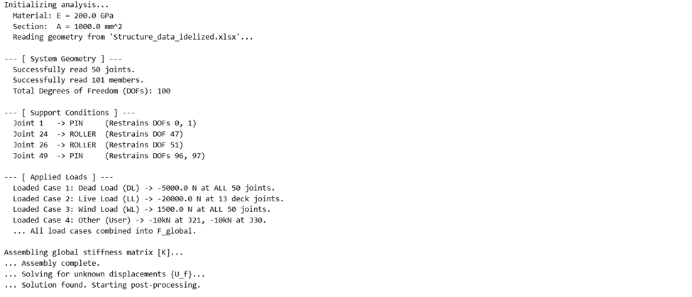
RESULTS

Slide 23
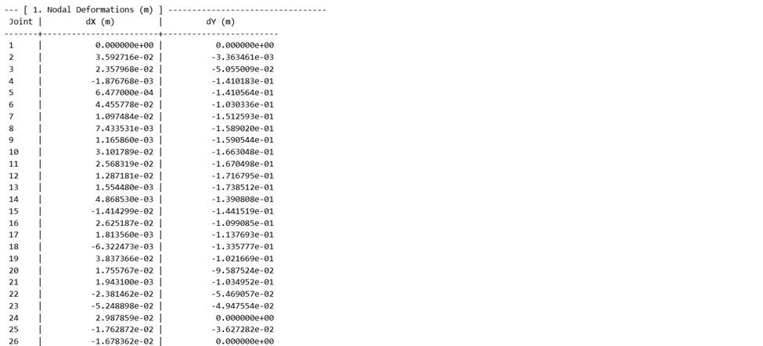
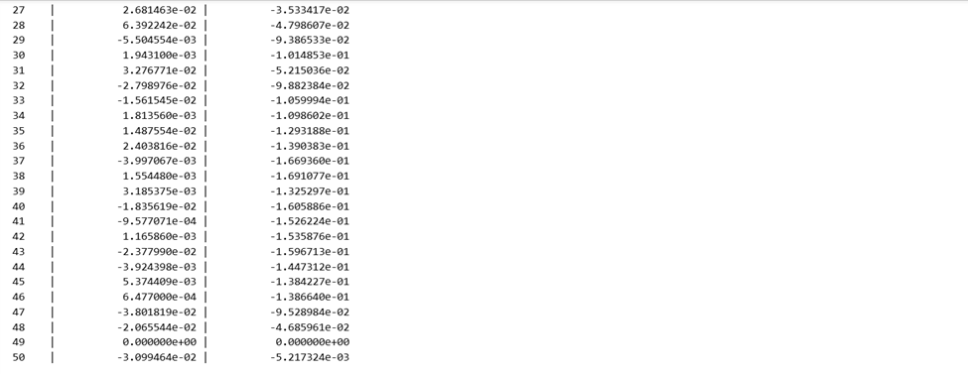
RESULTS

Slide 24
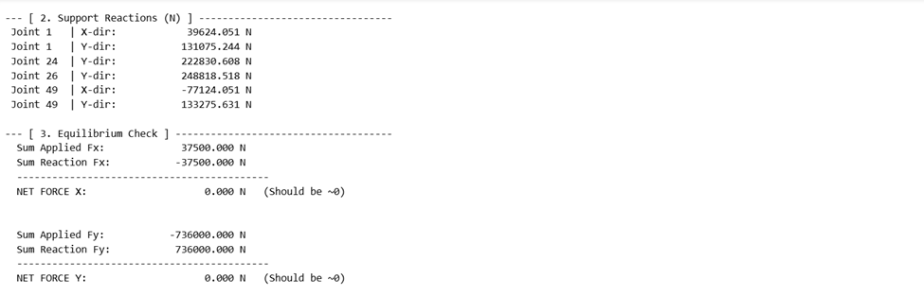
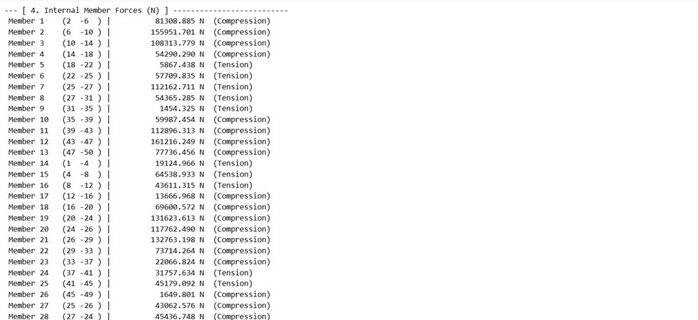
RESULTS

Slide 25
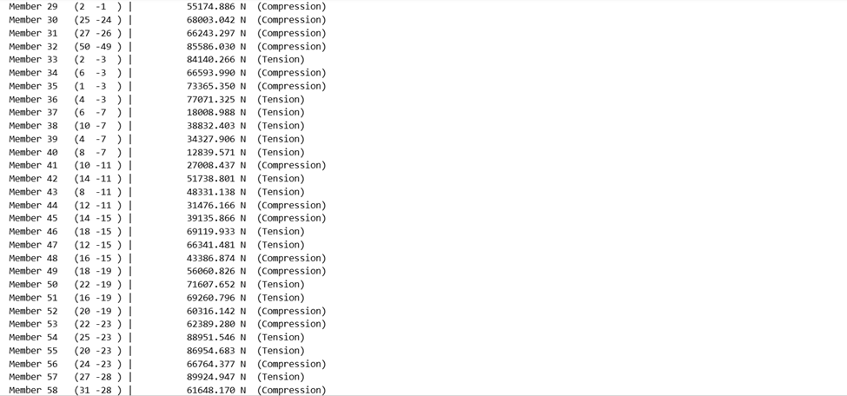
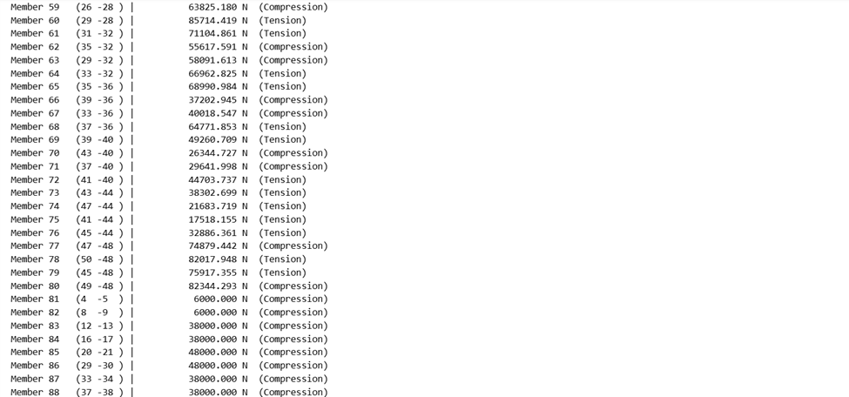
RESULTS

Slide 26
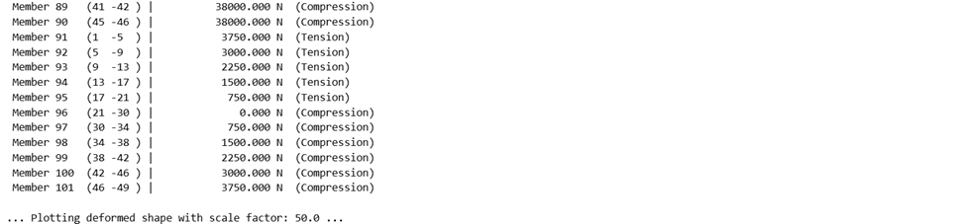
RESULTS

Slide 27
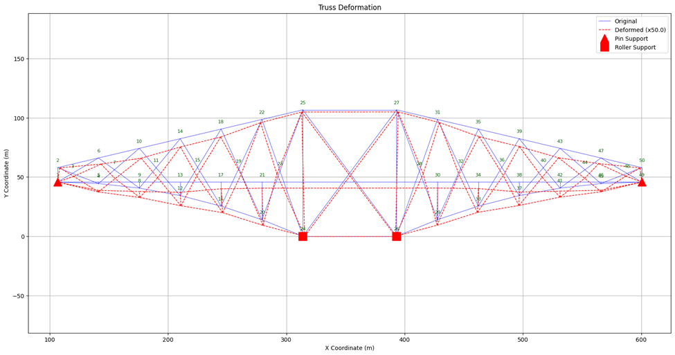
DEFORMED SHAPE OF THE STRUCTURE

Slide 28


Ranvir Kumar
23CE10050
Shubham Suman
23CE30029
Mayukh Mondal
23CE30020
R.Hanisree
23CE10056
P.Akshay Kumar
23CE10038
Shashank Sahil
23CE10065

Slide 29


Men
Demand Space
Thank You

